Slide 1
Consumer Complaint Analysis
Mayte Nunez Rangel, Andy Huynh, Christian Simental, Emanuel Zepeda, Ben Simanjuntak, Enrique Ramirez

Slide 2
Introduction / Background:
Dataset: Consumer Complaint Database (provided by catalog.data.gov)
Background Info: Collection of complaints from consumers about financial products and services.
Selected data set from 2021-2023
Data size: ~4.47 GB

Slide 3

H/W Specifications
Cluster Version - Hadoop 3.1.2
Cluster # of nodes - 5 nodes(2 master 3 work)
Memory size -
CPU Speed - 1995.312

Slide 4
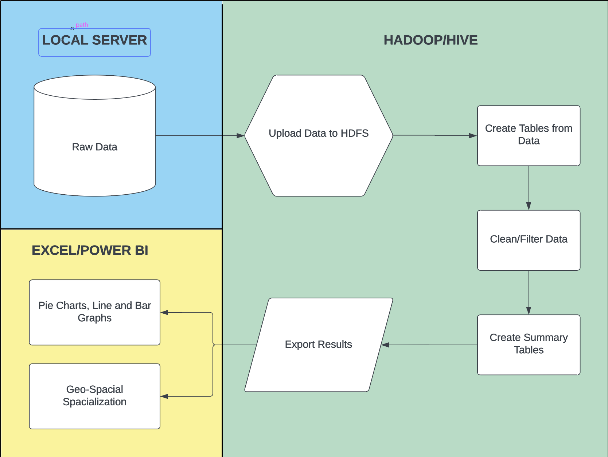
Flowchart / Workflow diagram

Slide 5
Methodology
Hive tables for structured query
To find out which companies have the most problems
Which problem is rated the highest
Where in the US has the most reported problems
Sentiment analysis
Using geospatial analysis to find sentiment
Ngram
Exploring ngram to find most common words in a set
Analysis through Tableau & Excel
Visualizing the data received from queries as 3D-maps and charts

Slide 6
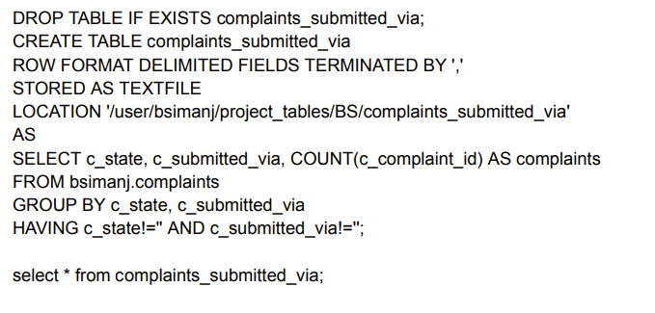
Hive - Analysis (Complaints Submitted Via)

Slide 7
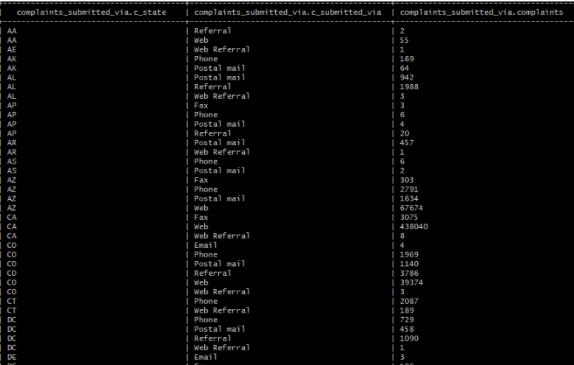
Hive - Analysis (Complaints Submitted Via)

Slide 8
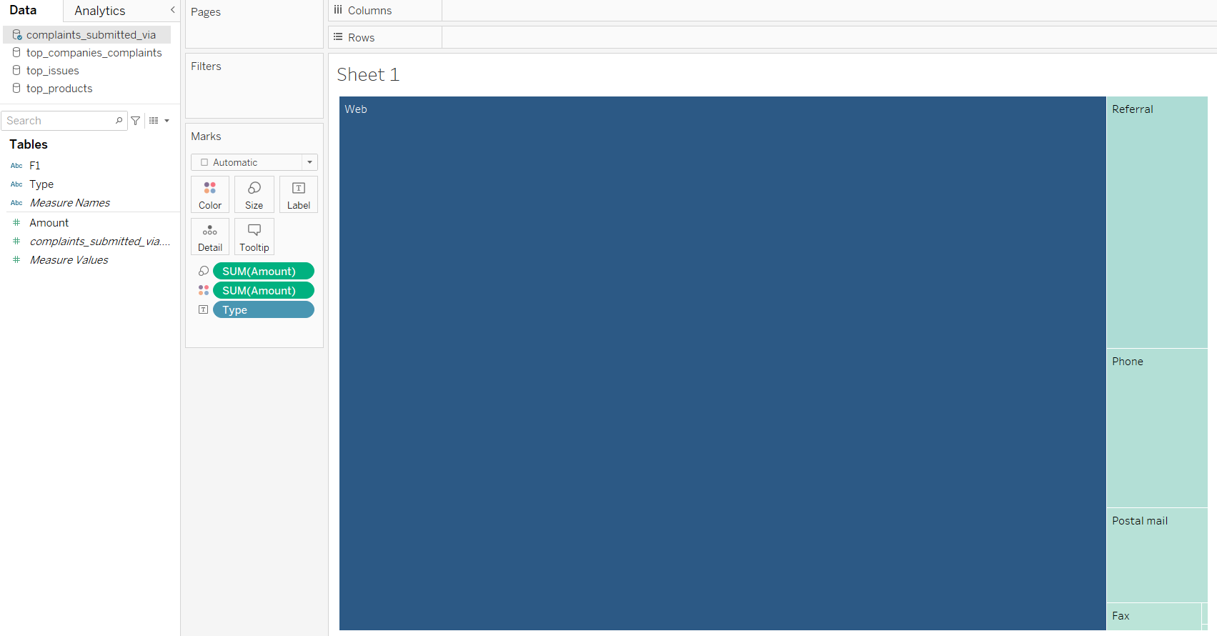
Hive - Analysis (Complaints Submitted Via)

Slide 9
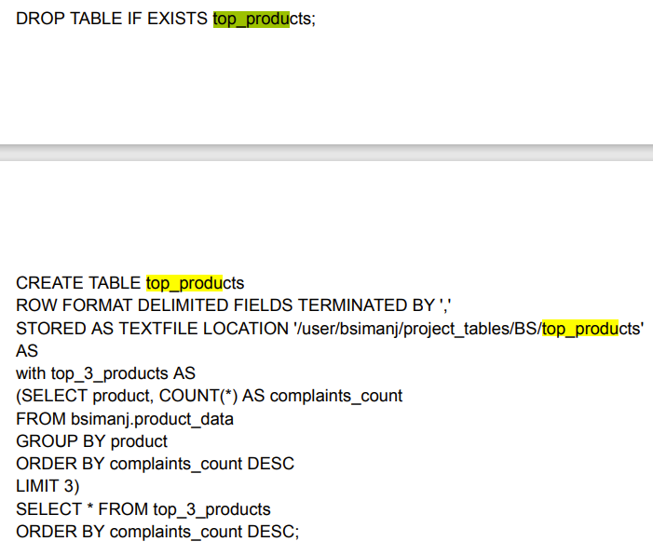
Hive - Analysis (Top Products)

Slide 10
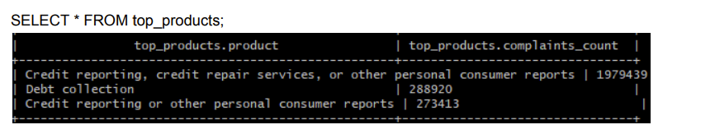
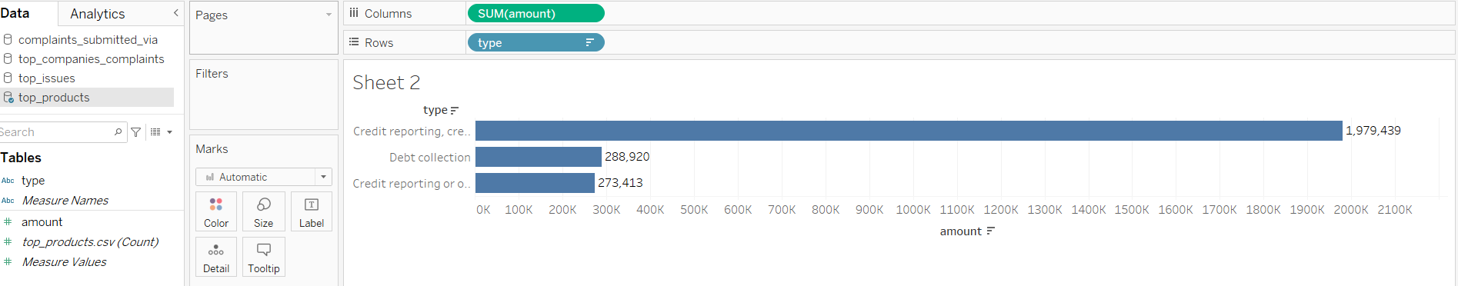
Hive - Analysis (Top Products)

Slide 11
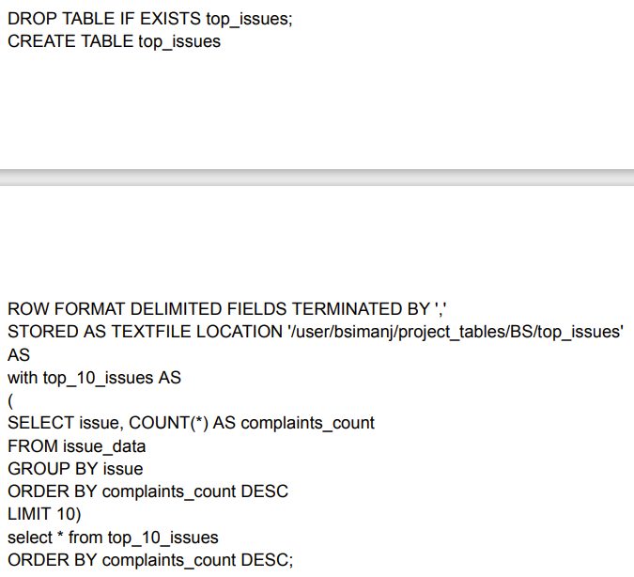
Hive - Analysis (Top Issues)

Slide 12
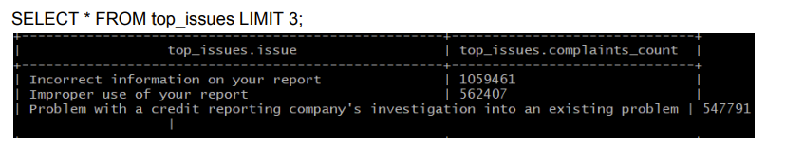
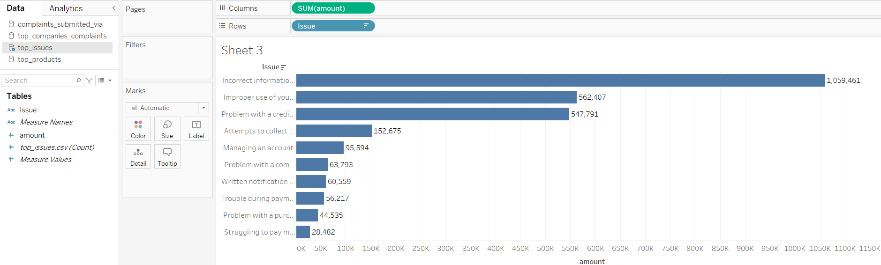
Hive - Analysis (Top Issues)

Slide 13
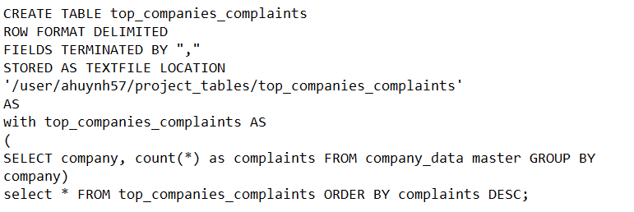
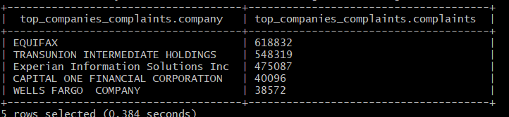
Hive - Analysis (Top Company Complaints)

Slide 14
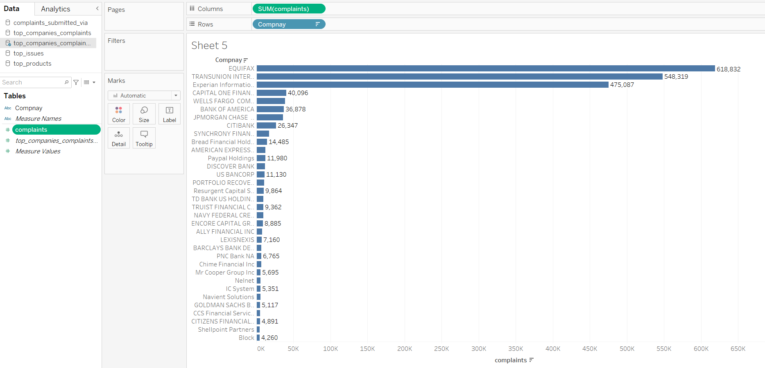
Hive - Analysis (Top Company Complaints)

Slide 15
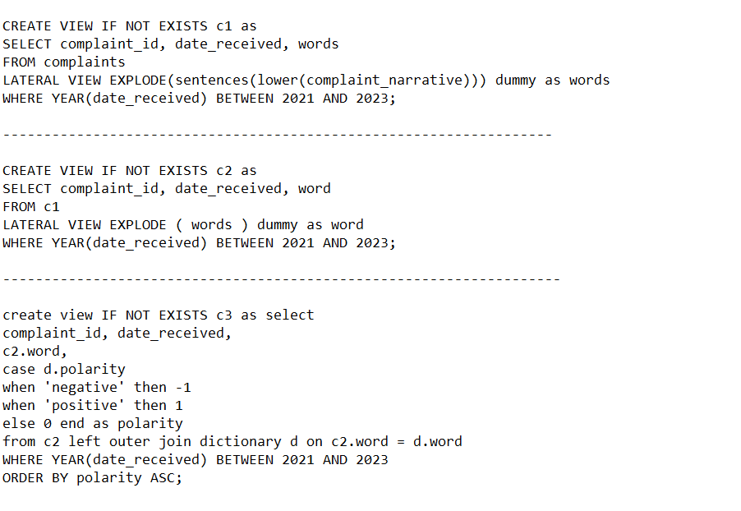
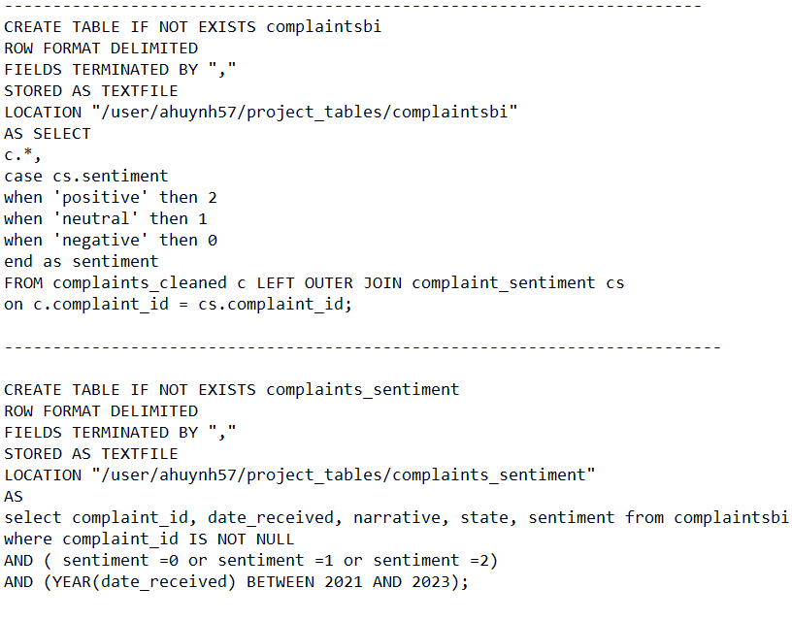
Sentiment - Analysis

Slide 16
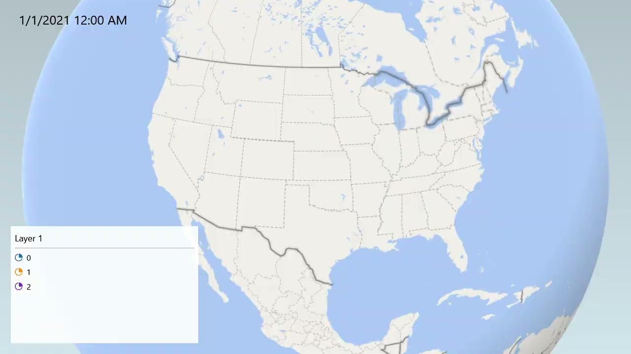
Sentiment - Analysis

Slide 17
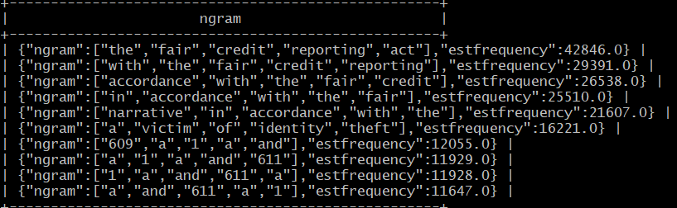
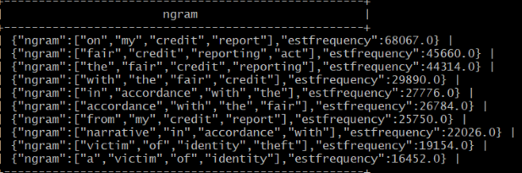
Ngram - Analysis
In two Ngrams, one being Equifax(4,10) and Wells Fargo(5,10), the most frequent words of prominence were ‘fair’, ‘credit’, ‘reporting’, act.and victim, of, identity, and theft usually in that order.
Both display ‘a’ , ‘victim’ , ‘of’ ,’identity’ , ‘theft’ which shows this is something both companies should look towards fixing.

Slide 18
References and links:
Data URL: Consumer Complaint Database - Catalog
Github link: ILOVECIS4560/CIS-4560-Project: Class project for CIS 4560 (github.com)

